Slide 1
Network Programmability using Netmiko for those New to Python
Rick Graziani
Cabrillo College
University of California Santa Cruz
2023

Slide 2
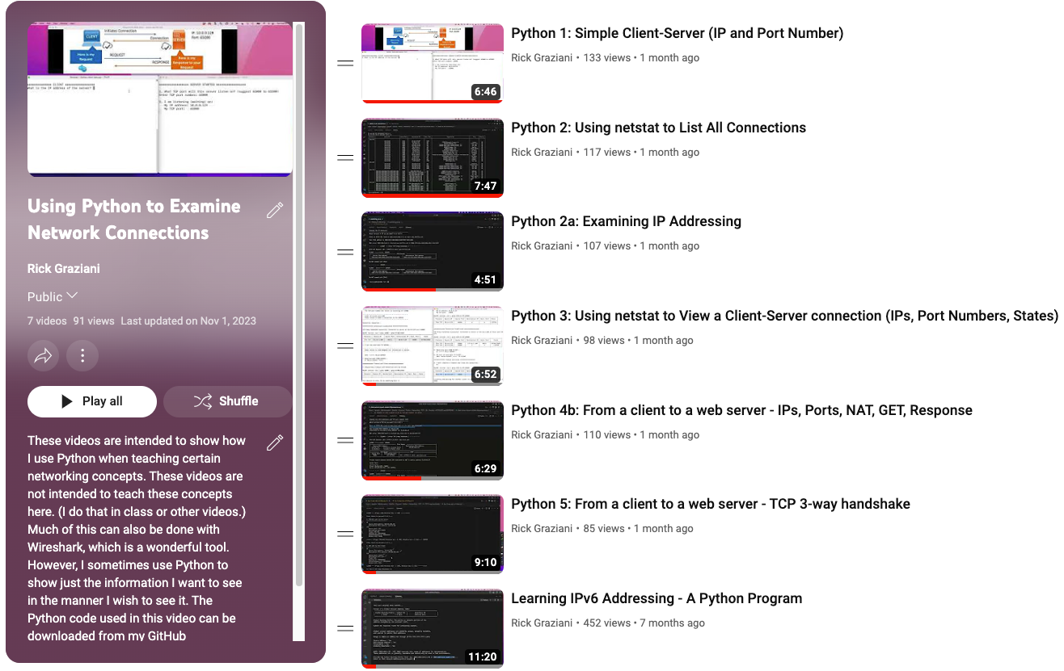
Agenda
Why Netmiko? (quick)
Netmiko's 3 basic commands (methods)
Import Netmiko
Connect to your device
Disconnect from your device
Sending an IOS command with:
send_command()
send_command_expect()
'copy run start' with save_config()
Configuring your IOS device with:
send_command()
send_command_set()
send_command_from_file()
Summary
Python
Keeping code and terms simple for those NEW to Python
Many options and variations including use of dictionaries, functions, etc.
Contact me offline or see coming YouTube channel and code
Just using: print() and a variable
One 'for loop' to show accessing multiple devices
At the end:
Access to my Python code for Netmiko and TCP/IP (code and videos)

Slide 3






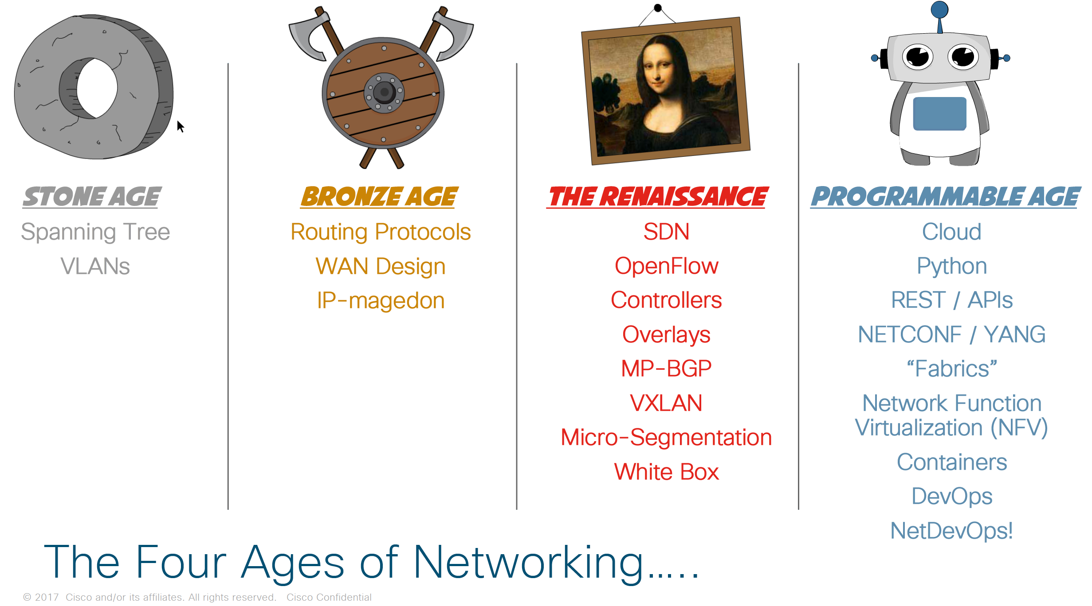
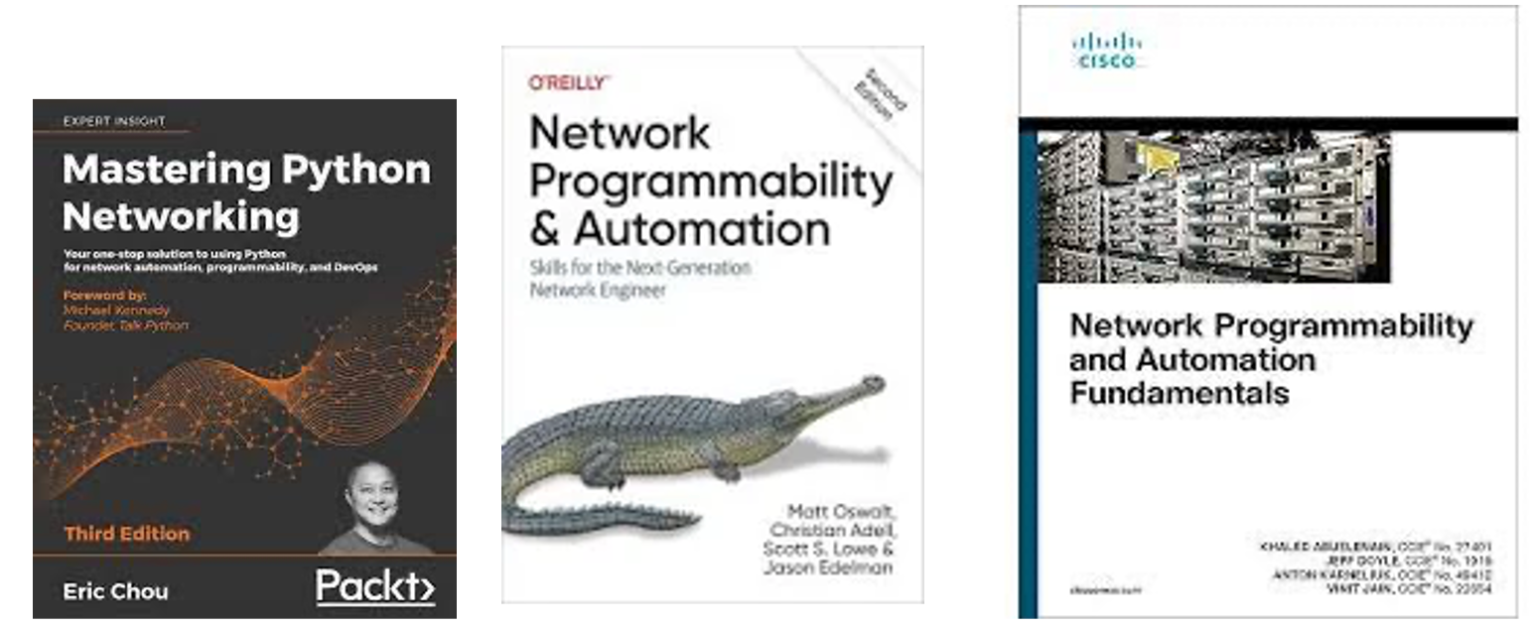
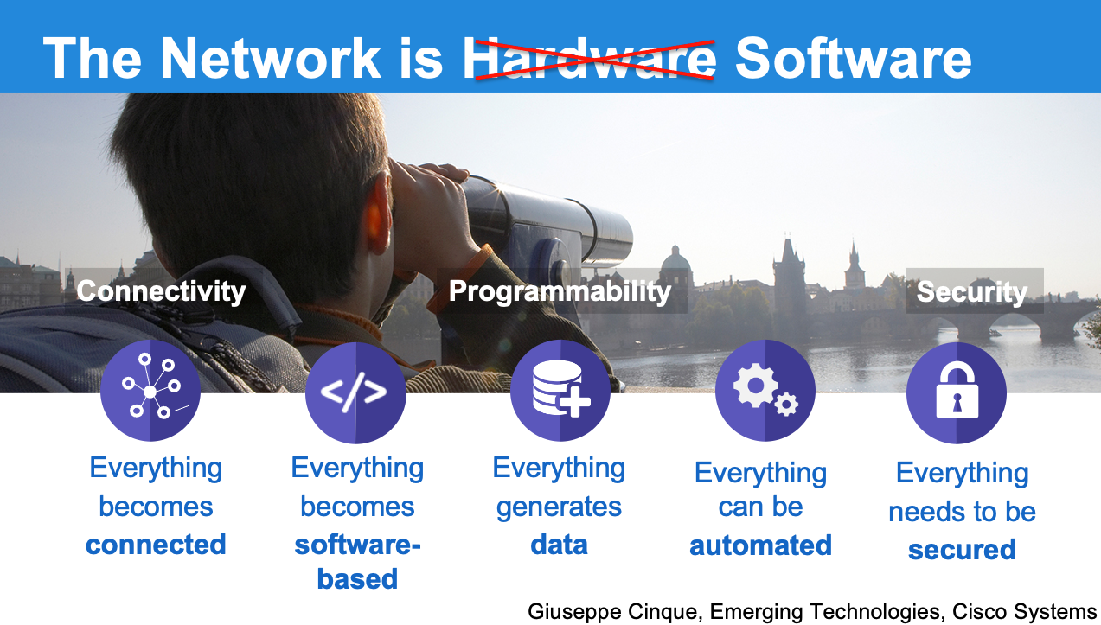
Cisco IT students
Besides DevNet…
Future of networking
Software Developers
Cisco Routing and Switching
Network Programmability and Automation
NETCONF, RESTCONF, YANG, APIs
Netmiko
(and others)
Is DevNet the only or best option to learn network automation?
I would like to learn coding but I'm not sure how it relates to networking?
Python
CCNA or Net Essentials or Net Basics
Cisco IOS

Slide 4

Netmiko offers a higher-level abstraction with features tailored specifically for network automation.
Netmiko or NAPALM
+Inventory (Ansible)
IOS commands
+ Inventory
NETCONF RPC (SSH)
REST API (Postman)
IOS commands
Generic commands
Netmiko
(Start Here)
NAPALM
(Intermediate)
NORNIR
(Advanced)
Ansible
(YAML, Python)
NETCONF
(XML)
RESTCONF
(JSON/XML)
YANG
Structured Data
JSON-YAML-XML
Python
Python
Python
Cisco IOS or XR/XE/NX-OS
+ SSH (Telnet)
Cisco XR/XE/NX-OS
+ API support

Slide 5








Why Netmiko?
Students with minimum knowledge of Python get to do some cool coding!
Students with even a very limited knowledge of IOS, get to "program" routers/switches!
Uses Cisco IOS commands (advantage for beginner)
Minimal Requirements: Requires only Telnet or SSH connectivity
As you grow with IOS or as you grow with Python you can do more network automation with Netmiko (developed by Kirk Byers)
SSH
Telnet

Slide 6
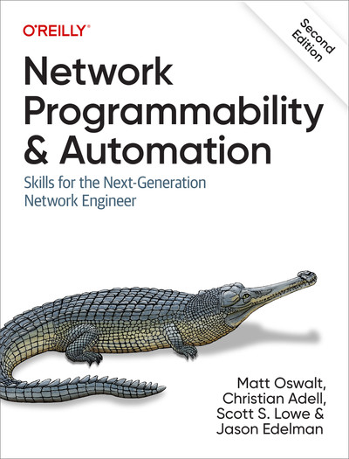
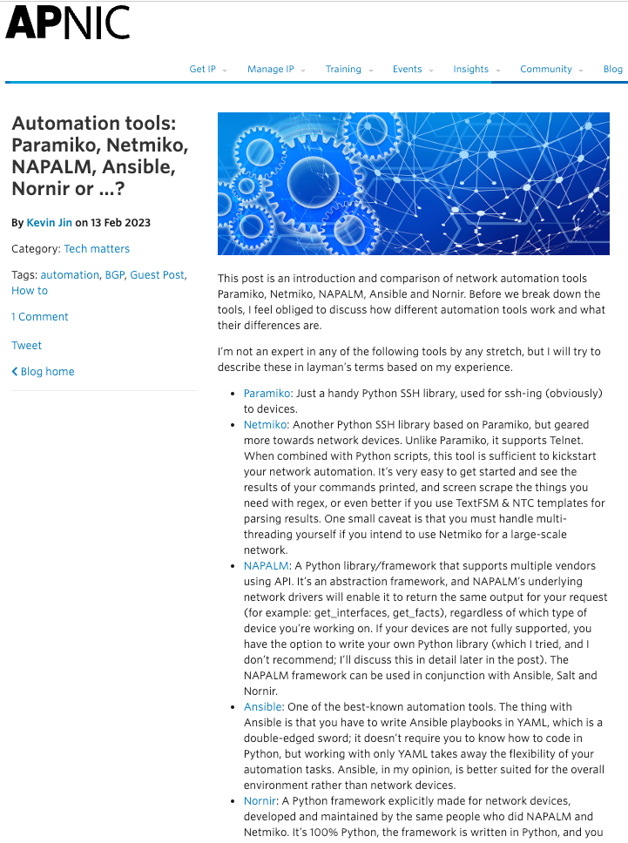

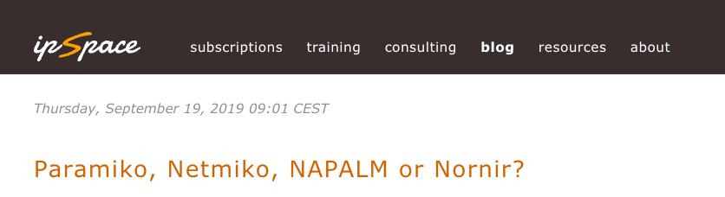
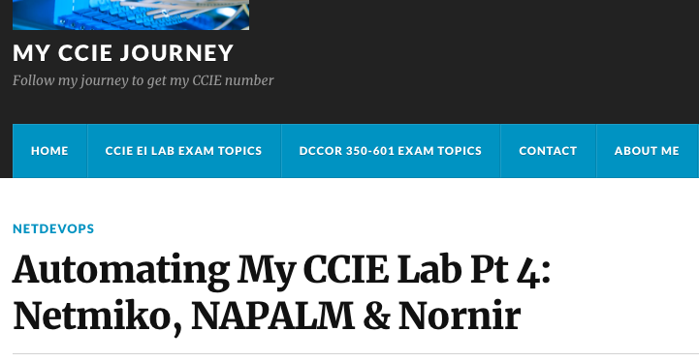


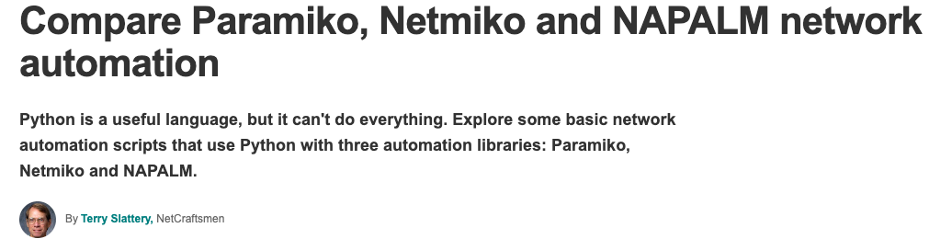
“Do not underestimate the utility of the SSH Netmiko library, as it’s proven useful in providing a smooth transition from traditional network CLI management to network automation, and it’s heavily used and developed”
Ivan Pepelnjak
"Netmiko is a Python library built on top of Paramiko that addresses these problems. If you want to connect to a wide variety of network devices without losing your sanity Netmiko is your best bet."

Slide 7


Getting Started
Install Python
Install Netmiko
MacOS% pip3 install netmiko
3. Verify SSH/Telnet connectivity to device

Slide 8
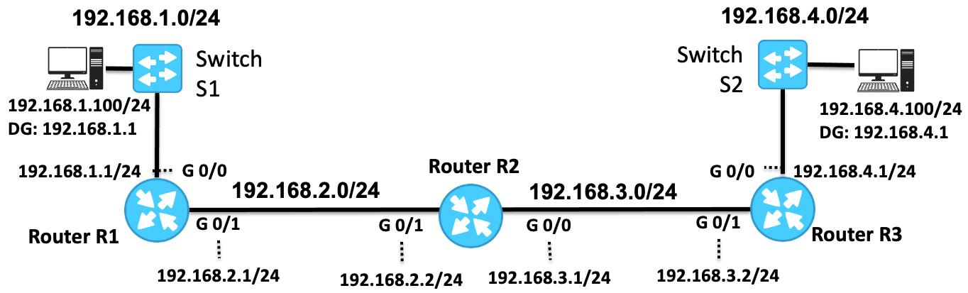

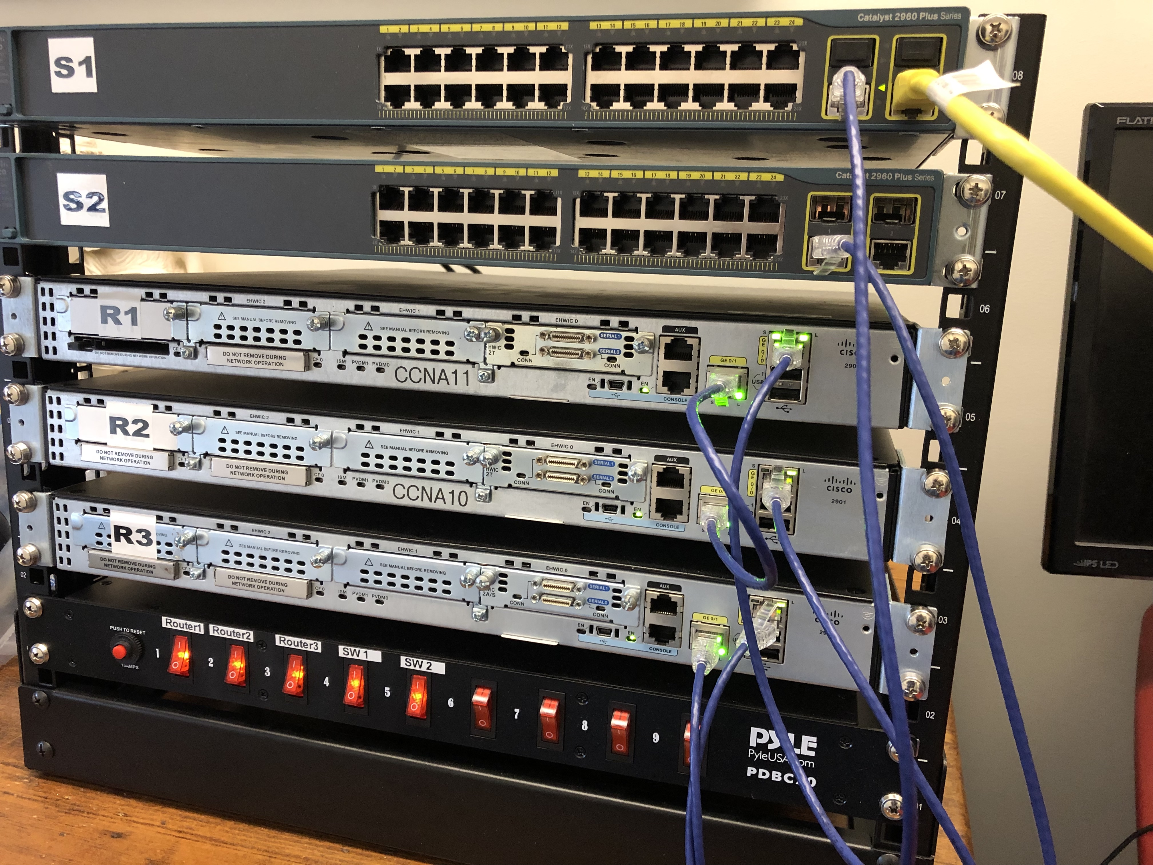
ME
Setup
Routers and switches preconfigured
IPv4 static routes for reachability
Can SSH to any device

Slide 9
Can you figure out what this does?
It really is that easy!
# Our first Netmiko program
import netmiko
connection = netmiko.ConnectHandler(ip='192.168.1.1',
device_type='cisco_ios',
username='admin',
password='cisco’)
print(connection.send_command('show ip interface brief'))
connection.disconnect()
Note: For telnet, use:
device_type='cisco_ios_telnet'

Slide 10
netmiko_1a_
# Required: Imports the Netmiko library
import netmiko
# Required: Netmiko ConnectHandler handles the SSH connection using specified 'arguments'
# The connection object (variable) represents the connection to the specified device
# Allows you to interact with it using various Netmiko methods like the send_command.
connection = netmiko.ConnectHandler(ip='192.168.1.1',
device_type='cisco_ios',
username='admin',
password='cisco’)
# Using the connection object, the send_command method sends a command
# to a network device and retrieves the corresponding output.
print(connection.send_command('show ip interface brief’))
# Required: The disconnect method in Netmiko is used to close the SSH connection
# to a network device, ensuring proper cleanup
connection.disconnect()
1
Device IP address
2
Device OS
SSH username &password
This is the basic framework.
Just add Netmiko/IOS commands!
3

Slide 11
send_command() Another option
# Imports the Netmiko library
import netmiko
connection = netmiko.ConnectHandler(ip='192.168.1.1',
device_type='cisco_ios',
username='admin',
password='cisco’)
# Previous command: Prints the output (if any) from the command
# print(connection.send_command('show ip interface brief’))
# Send output to a variable (output) and then print the (string) variable
output = connection.send_command('show ip interface brief’)
print(output)
connection.disconnect()
Same result when using send_command() but differences with other methods
netmiko_1a_

Slide 12
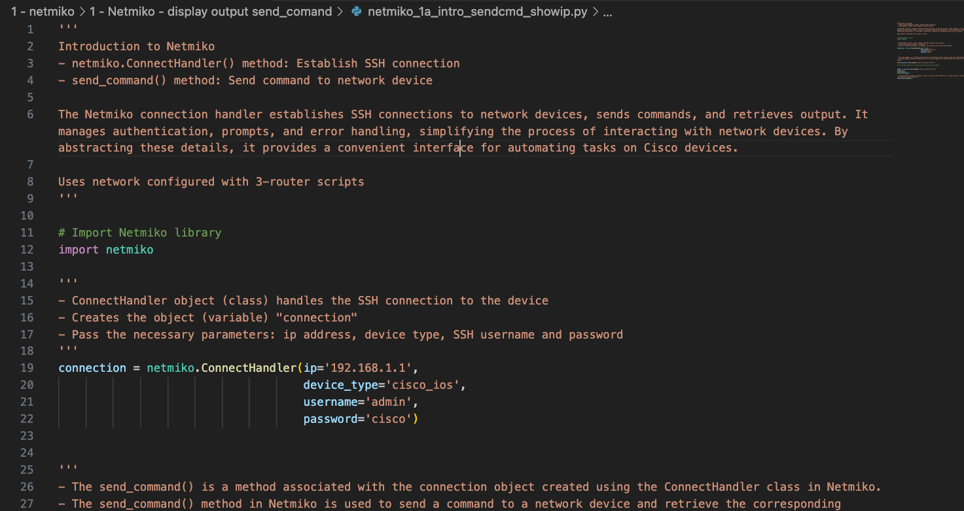
Let’s try it! send_command()
netmiko_1a_

Slide 13
Output (Backup)
Interface IP-Address OK? Method Status Protocol
Embedded-Service-Engine0/0 unassigned YES NVRAM administratively down down
GigabitEthernet0/0 192.168.1.1 YES NVRAM up up
GigabitEthernet0/1 192.168.2.1 YES NVRAM up up
Serial0/0/0 unassigned YES NVRAM administratively down down
Serial0/0/1 unassigned YES NVRAM administratively down down
Interface IP-Address OK? Method Status Protocol
Embedded-Service-Engine0/0 unassigned YES NVRAM administratively down down
GigabitEthernet0/0 192.168.1.1 YES NVRAM up up
GigabitEthernet0/1 192.168.2.1 YES NVRAM up up
Serial0/0/0 unassigned YES NVRAM administratively down down
Serial0/0/1 unassigned YES NVRAM administratively down down
MacOS%

Slide 14
send_command_expect() When IOS expects input/confirmation
import netmiko
connection = netmiko.ConnectHandler(ip='192.168.1.1',
device_type='cisco_ios',
username='admin',
password='cisco’)
# send_command_expect() method is used to specify a string that Netmiko should
# expect to see in the command's output before considering the command as complete.
# Used for confirmation and automatically responds to prompt
# expect_string should be unique enough to identify the point at which the script
# needs to take action, ex. Destination filename [startup-config]?
print(connection.send_command_expect('copy running-config startup-config',
expect_string='Destination filename'))
connection.disconnect()

Slide 15
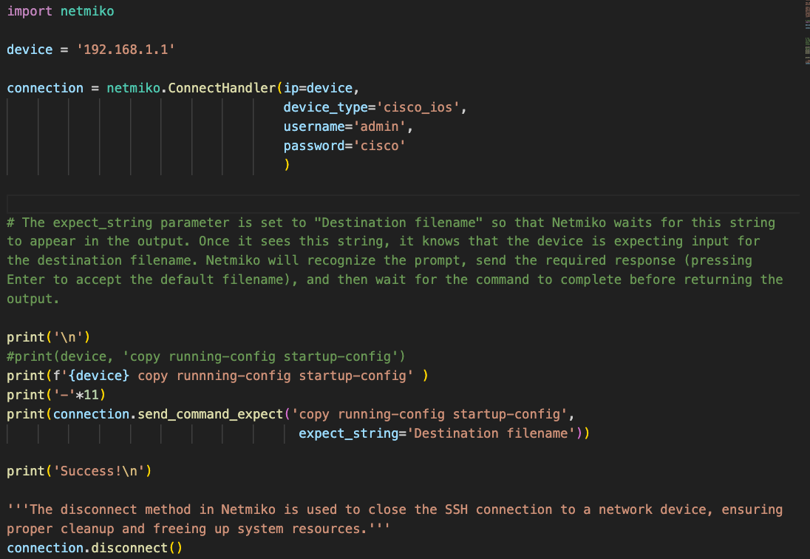
Let’s try it! send_command_expect()
Added some print commands for readability
Insignificant Python Change:
Assigned IPv4 address of the device to a string variable so I can print the IPv4 address later.

Slide 16
Output (Backup)
MacOS%
192.168.1.1 copy running-config startup-config
-----------
Destination filename [startup-config]?
Success!
MacOS%

Slide 17
save_config() Same as 'copy run start'
import netmiko
connection = netmiko.ConnectHandler(ip='192.168.1.1',
device_type='cisco_ios',
username='admin',
password='cisco')
print("\n")
print("Save running-config to startup-config...")
connection.save_config()
print("Success!")
print("\n")
print("show startup-config...")
print(connection.send_command('show startup-config'))
connection.disconnect()

Slide 18
Output (Backup)
MacOS%
Save running-config to startup-config...
Success!
show startup-config...
Using 1942 out of 262136 bytes
!
version 15.4
service timestamps debug datetime msec
service timestamps log datetime msec
no service password-encryption
!
hostname R2
!
boot-start-marker
boot-end-marker
!
<output omitted>
MacOS%

Slide 19
So far…
show commands, saving config
import netmiko
connection = netmiko.ConnectHandler(ip='192.168.1.1',
device_type='cisco_ios',
username='admin',
password='cisco')
# Secret password not required (enable secret class) for these commands
# However, there are ways to 'secure' these commands within Cisco IOS
print(connection.send_command('User Exec IOS Command'))
print(connection.send_command('show running-config'))
print(connection.send_command_expect('copy running-config startup-config',
expect_string='Destination filename'))
connection.save_config()
connection.disconnect()
Related code you can download from Rick…
Do an extended ping with send_command_expect()
Display the prompt with find_prompt()

Slide 20
send_command() Using config mode to configure device
import netmiko
connection = netmiko.ConnectHandler(ip='192.168.1.1',
device_type='cisco_ios',
username='admin',
password='cisco',
secret='class') # Enable password
# send_command() for configuration is similar to CLI - secret password is required
connection.enable() # Privileged exec mode
connection.config_mode() # Global config mode
connection.send_command('access-list 1 permit any') # Global configuration command
connection.exit_config_mode() # Exit global config mode
print(connection.send_command('show running-config | section access-list 1')) # Verify
connection.disconnect()

Slide 21
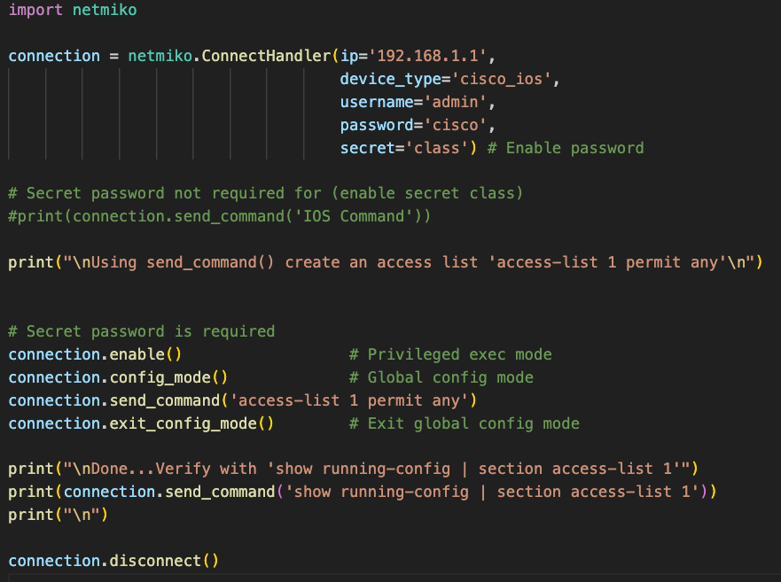
Let’s try it! send_command(): Configuring Devices
1f_sendcmd_config.py
Added some print commands for readability

Slide 22
Output (Backup)
MacOS%
Using send_command() create an access list...
Done...Verify with 'show running-config | section access-list 1'
access-list 1 permit any
MacOS%

Slide 23
send_command_set() Using a list of commands (a better way?)
import netmiko
device = '192.168.1.1'
ipv6_interface_list = [
'ipv6 unicast-routing',
'interface g0/0',
'ipv6 address 2001:db8:cafe:1::1/64',
'ipv6 address fe80::1:1 link-local',
'exit',
'interface g0/1',
'ipv6 address 2001:db8:cafe:2::1/64',
'ipv6 address fe80::1:2 link-local'
]
connection = netmiko.ConnectHandler(
ip=‘device',
device_type='cisco_ios',
username='admin',
password='cisco',
secret='class')
# send_config_set() method can use commands
# from a list, a string, or from a file to a
# list.
# Requires privileged exec access
# Handles configuration mode
# connection.enable() not needed
connection.send_config_set(ipv6_interface_list)
# Verify
print(device)
print(connection.send_command('show ipv6 interface brief'))
connection.disconnect()

Slide 24
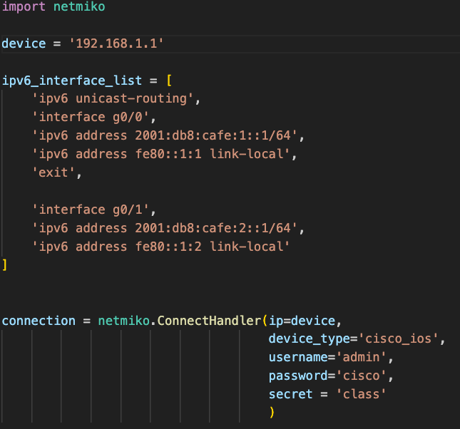
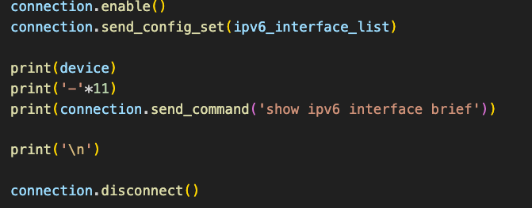
Let’s try it! send_command_set(): Configuring Devices
4a_sendconfigset_fromlist.py

Slide 25
Output (Backup)
MacOS%
192.168.1.1
-----------
Em0/0 [administratively down/down]
unassigned
GigabitEthernet0/0 [up/up]
FE80::1:1
2001:DB8:CAFE:1::1
GigabitEthernet0/1 [up/up]
FE80::1:2
2001:DB8:CAFE:2::1
Serial0/0/0 [administratively down/down]
unassigned
Serial0/0/1 [administratively down/down]
unassigned
MacOS%

Slide 26
output = send_command_set() Display Commands
import netmiko
device = '192.168.2.1'
ipv6_interface_list = [
'ipv6 unicast-routing',
'interface g0/0',
'ipv6 address 2001:db8:cafe:3::1/64',
'ipv6 address fe80::3:3 link-local',
'exit',
'interface g0/1',
'ipv6 address 2001:db8:cafe:2::2/64',
'ipv6 address fe80::3:2 link-local'
]
connection = netmiko.ConnectHandler(
ip=‘device',
device_type='cisco_ios',
username='admin',
password='cisco',
secret='class')
# Stores the output of the configuration commands (prompts and commands) to the variable output.
output =
connection.send_config_set(ipv6_interface_list)
# Print output: prompts and commands
print(output)
# Verify
print(connection.send_command('show ipv6 interface brief'))
connection.disconnect()

Slide 27
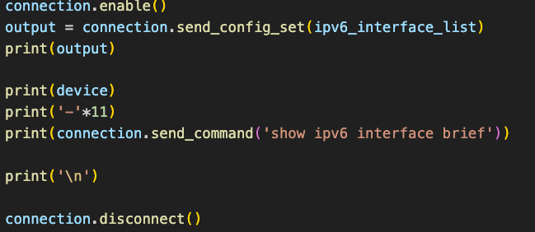
Let’s try it! send_command_set(): Display Commands
4b_sendconfigset_fromlist_displaycommands.py

Slide 28
MacOS%
configure terminal
Enter configuration commands, one per line. End with CNTL/Z.
R1(config)#ipv6 unicast-routing
R1(config)#interface g0/0
R1(config-if)#ipv6 address 2001:db8:cafe:1::1/64
R1(config-if)#ipv6 address fe80::1:1 link-local
R1(config-if)#exit
R1(config)#interface g0/1
R1(config-if)#ipv6 address 2001:db8:cafe:2::1/64
R1(config-if)#ipv6 address fe80::1:2 link-local
R1(config-if)#end
R1#
Output (Backup)
R1#
192.168.1.1
-----------
Em0/0 [administratively down/down]
unassigned
GigabitEthernet0/0 [up/up]
FE80::1:1
2001:DB8:CAFE:1::1
GigabitEthernet0/1 [up/up]
FE80::1:2
2001:DB8:CAFE:2::1
Serial0/0/0 [administratively down/down]
unassigned
Serial0/0/1 [administratively down/down]
unassigned
MacOS%

Slide 29
output = send_command_from_file()
import netmiko
# File containing configuration commands
config_file = 'r1-ipv6-config.txt'
device = '192.168.1.1'
# Define device parameters
connection = netmiko.ConnectHandler(
ip=‘device',
device_type='cisco_ios',
username='admin',
password='cisco',
secret='class')
# Use send_config_from_file() to send
# configuration commands from a file
output = connection.send_config_from_file(config_file)
print(f"Config Output:\n{output}\n")
print("Verify configuration")
print(connection.send_command('show ipv6 interface brief'))

Slide 30
output = send_command_from_file()
4c_send_config_from_file_output_simple.py
Actual file
import netmiko
import os
# Get the directory of the current script
script_directory = os.path.dirname(os.path.abspath(__file__))
# Specify the file containing configuration commands
config_file = os.path.join(script_directory, 'r1-ipv6-config.txt')
# Define device parameters
device = {
'device_type': 'cisco_ios',
'ip': '192.168.1.1',
'username': 'admin',
'password': 'cisco',
'secret': 'class'
}
# Establish SSH connection
connection = netmiko.ConnectHandler(**device)
print("SSH Connection Successful\n")
print("\nBefore configuration")
print(connection.send_command('show ipv6 interface brief'))
# Use send_config_from_file() to send configuration commands from a file
output = connection.send_config_from_file(config_file)
print(f"Config Output:\n{output}\n")
print("After configuration")
print(connection.send_command('show ipv6 interface brief'))

Slide 31
'r1-ipv6-config.txt
interface gig 0/0
ipv6 address 2001:db8:cafe:1::1/64
ipv6 address fe80::1:1 link-local
exit
interface gig 0/1
ipv6 address 2001:db8:cafe:2::1/64
ipv6 address fe80::1:2 link-local
exit

Slide 32
MacOS%
Config Output:
configure terminal
Enter configuration commands, one per line. End with CNTL/Z.
R1(config)#interface gig 0/0
R1(config-if)#ipv6 address 2001:db8:cafe:1::1/64
R1(config-if)#ipv6 address fe80::1:1 link-local
R1(config-if)#exit
R1(config)#
R1(config)#interface gig 0/1
R1(config-if)#ipv6 address 2001:db8:cafe:2::1/64
R1(config-if)#ipv6 address fe80::1:2 link-local
R1(config-if)#exit
R1(config)#end
R1#
Output (Backup)
After configuration
GigabitEthernet0/0 [up/up]
FE80::1:1
2001:DB8:CAFE:1::1
GigabitEthernet0/1 [down/down]
FE80::1:2
2001:DB8:CAFE:2::1
GigabitEthernet0/2 [administratively down/down]
unassigned
MacOS%

Slide 33
import netmiko
# Assign devices to a list of IP addresses used to SSH into each device
devices = ['192.168.1.1', '192.168.2.2', '192.168.3.2']
# Loop through the IP addresses, assign device to each item in the list of devices
for device in devices:
connection = netmiko.ConnectHandler(ip=device,
device_type='cisco_ios',
username='admin',
password='cisco')
# Print current value of device (IPv4 address) and output from send_command()
print(device)
print(connection.send_command('show ip route static'))
connection.disconnect()
for loop - Accessing multiple devices
(For those more familiar with Python)

Slide 34
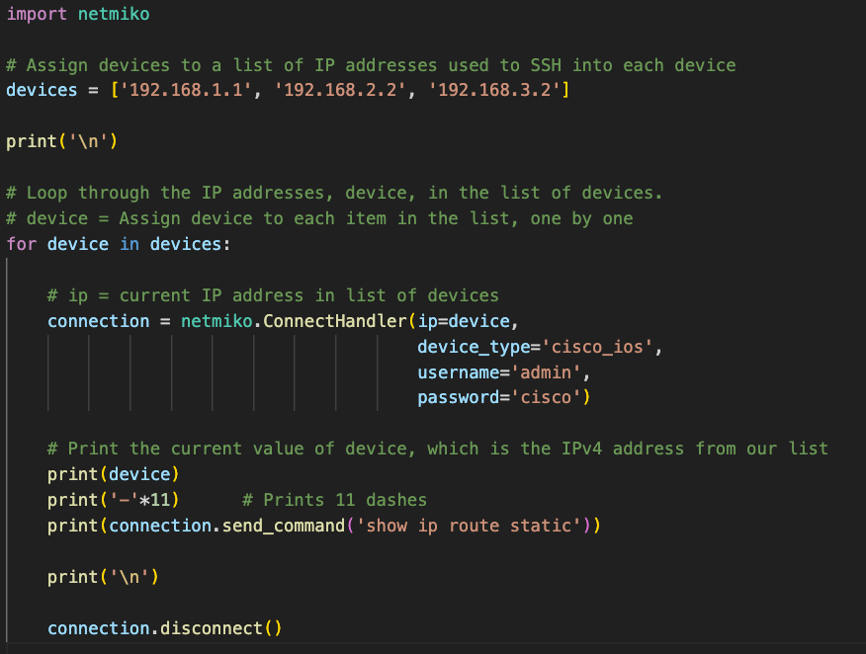
Let’s try it! For Loop and a List of Devices
2a_forloop_listip_sendcmd.py
For those who are familiar with dictionaries, each device can be a dictionary with its own usernames, passwords, device types:
See Rick’s stuff for more information.

Slide 35
MacOS%
192.168.1.1
-----------
Codes: L - local, C - connected, S - static, R - RIP, M - mobile, B - BGP
D - EIGRP, EX - EIGRP external, O - OSPF, IA - OSPF inter area
N1 - OSPF NSSA external type 1, N2 - OSPF NSSA external type 2
E1 - OSPF external type 1, E2 - OSPF external type 2
i - IS-IS, su - IS-IS summary, L1 - IS-IS level-1, L2 - IS-IS level-2
ia - IS-IS inter area, * - candidate default, U - per-user static route
o - ODR, P - periodic downloaded static route, H - NHRP, l - LISP
+ - replicated route, % - next hop override
Gateway of last resort is not set
S 192.168.3.0/24 [1/0] via 192.168.2.2
S 192.168.4.0/24 [1/0] via 192.168.2.2
<Next slide>
Output (Backup)

Slide 36
192.168.2.2
-----------
Codes: L - local, C - connected, S - static, R - RIP, M - mobile, B - BGP
<output omitted>
S 192.168.1.0/24 [1/0] via 192.168.2.1
S 192.168.4.0/24 [1/0] via 192.168.3.2
192.168.3.2
-----------
Codes: L - local, C - connected, S - static, R - RIP, M - mobile, B - BGP
<output omitted>
S 192.168.1.0/24 [1/0] via 192.168.3.1
S 192.168.2.0/24 [1/0] via 192.168.3.1
MacOS%
Output (Backup)

Slide 37
Some ideas for those familiar with some of this… (Otherwise, ignore this ☺)
Configure multiple devices using a separate files with IOS commands for each device
Include Cisco EEM (Embedded Event Manager) files for connection-sensitive configurations such as ACLs, IP addressing and routing
Require SSH and privileged passwords to be entered manually
Use a JSON file for list of devices
Use Netmiko with TextFSM and NTC Templates that converts semi-formatted text (the CLI output) to structured data
Etc.

Slide 38
import netmiko # Import Netmiko library
ipv6_interface_list = [ List of commands ]
config_file = 'r1-ipv6-config.txt'
connection = netmiko.ConnectHandler(ip='192.168.1.1’, device_type='cisco_ios',
username='admin’, password='cisco’, secret='class’)
print(connection.send_command('show ip interface brief'))
print(connection.send_command_expect('copy run start’, expect_string=‘filename'))
connection.enable() # Privileged exec mode
connection.config_mode() # Global config mode
connection.send_command('access-list 1 permit any') # Global configuration command
connection.exit_config_mode() # Exit global config mode
connection.send_config_set(ipv6_interface_list) # Send commands from a list
connection.send_config_from_file(config_file) # Send commands from a file
connection.save_config() # Same as 'copy run start'
connection.disconnect() # Close SSH connection
Summary

Slide 39
And you can start right here…
# Our first Netmiko program
import netmiko
connection = netmiko.ConnectHandler(ip='192.168.1.1',
device_type='cisco_ios',
username='admin',
password='cisco’)
print(connection.send_command('show ip interface brief'))
connection.disconnect()

Slide 40
You are welcome to any of my Python networking programs.
Real-time, specific TCP/IP information:
YouTube: What it does
GitHub: The code
One condition, same as I tell all my students…
You can’t criticize my code ☺
Netmiko playlist and GitHub repository coming soon! (Will post of Facebook IPD)

Slide 41

https://www.linkedin.com/in/rick-graziani-4194674/
Google Drive
https://drive.google.com/drive/folders/13-AlEJe-8seCXapQzfpAbci0aNEnlJn3?usp=drive_link
YouTube
https://www.youtube.com/@rickgraziani6055/playlists
GitHub
https://github.com/rigrazia?tab=repositories
Email
graziani@cabrillo.edu
rgrazian@ucsc.edu

Slide 42

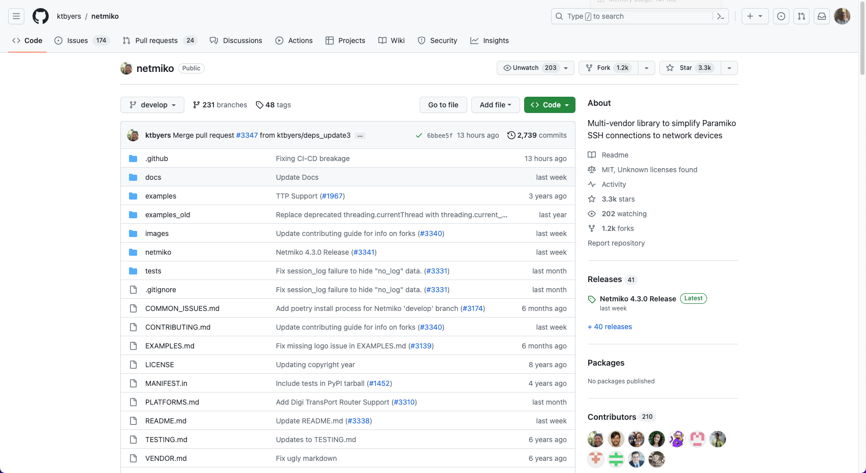
Netmiko developed by Kirk Byers
https://github.com/ktbyers/netmiko

Slide 43
import netmiko
connection = netmiko.ConnectHandler(ip='192.168.1.1',
device_type='cisco_ios', username='admin', password='cisco', secret='class')
connection.enable() # Required: Privileged exec mode
connection.config_mode() # Global config mode – Not required for other sub-modes
connection.exit_config_mode() # Exit global config mode
connection.interface_mode() # Followed by sending a list of interface commands
connection.exit_interface_mode() # Exit interface mode
connection.line_mode() # Followed by sending a list of VTY or con commands
connection.exit_line_mode() # Exit line mode
connection.disconnect()
send_command_set() and other sub-modes

Slide 44
import netmiko
connection = netmiko.ConnectHandler(ip='192.168.1.1',
device_type='cisco_ios', username='admin', password='cisco', secret='class')
console_config_commands = [
'line con 0', # Access the console line
'logging synchronous' # Enable synchronous logging
]
connection.enable() # Required: Privileged exec mode
connection.line_mode()
output = connection.send_config_set(console_config_commands)
print(f"Configuration Output:\n{output}\n")
connection.exit_line_mode() # Exit line mode (optional here)
connection.disconnect()
send_command_set() and other sub-modes

